Slide 1
Chongqing University of Technology
Chongqing Unive
Node Similarity Preserving Graph
Convolutional Networks
（ WSDM-2021)
Reported by Luyuan Gao and Zhe Liu

Slide 2
ATAI
Chongqing University of Technology
Advanced Technique of Artificial Intelligence
Chongqing University of Technology
1. Introduction
2. Prove defect
3. Approach
4. Experiments
5. Conclusion

Slide 3
Introduction
• GCN explore the graph structure and node features by aggregating and transforming information within node neighborhoods. But GCN tends to preserve structural similarity rather than node similarity, so destroy the node similarity of the original feature space.
• We propose a novel GCN model that effectively preserves feature similarity and adaptively balances the information from graph structure and node features while simultaneously leveraging their rich information.
• Extensive experiments have demonstrated that the proposed framework can outperform representative baselines on both assortative and disassortative graphs. And that preserving feature similarity can significantly boost the robustness of GCN against adversarial attacks.

Slide 4
Prove defect

Slide 5
Prove defect

Slide 6
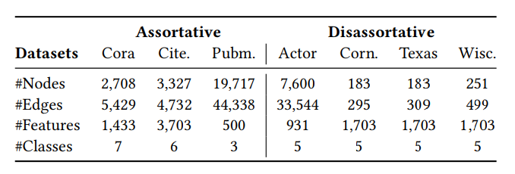
Prove defect

Slide 7
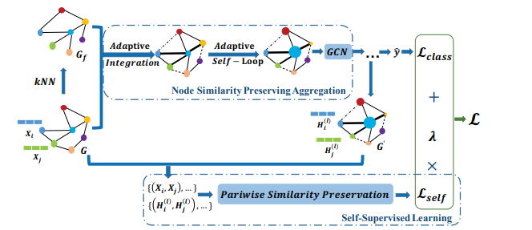
Approach
It has two major components node similarity preserving aggregation and self-supervised learning corresponding to how to balance the in-formation from graph structure and node features during aggregation and how to explicitly capture the complex pairwise feature similarity relations

Slide 8
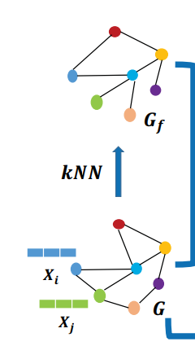
Approach
node similarity preserving aggregation

Slide 9
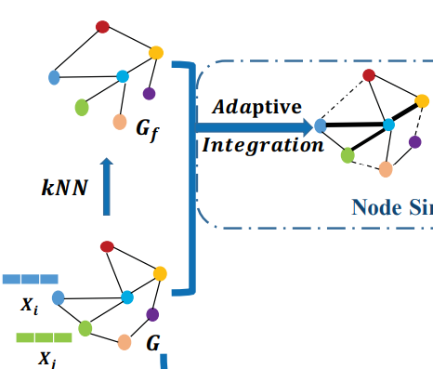
Approach
node similarity preserving aggregation

Slide 10
Approach
node similarity preserving aggregation

Slide 11
Approach
node similarity preserving aggregation

Slide 12
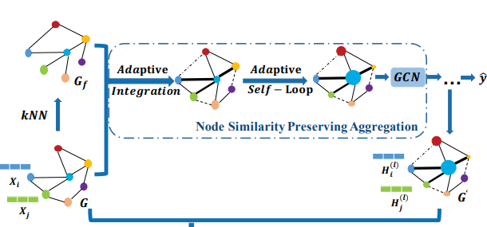
Approach
node similarity preserving aggregation

Slide 13
Approach
Self-Supervised Learning

Slide 14
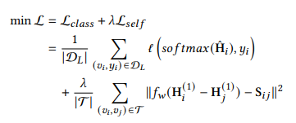
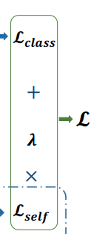
Approach
Overall Objective Function

Slide 15
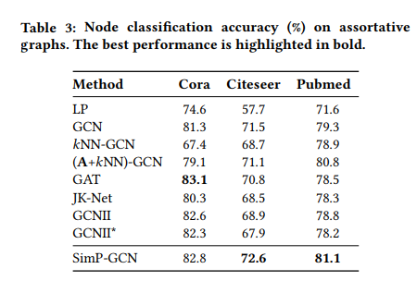
Experiments

Slide 16
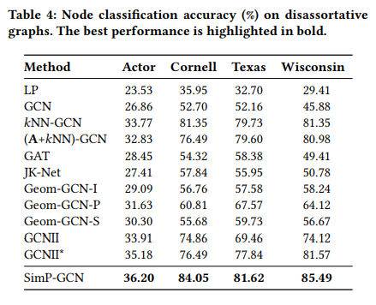
Experiments

Slide 17
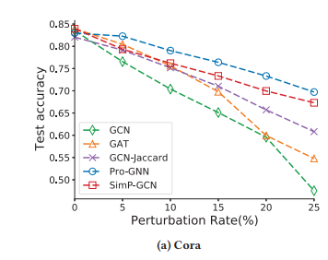
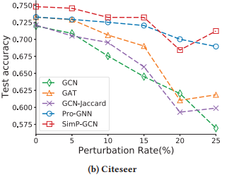
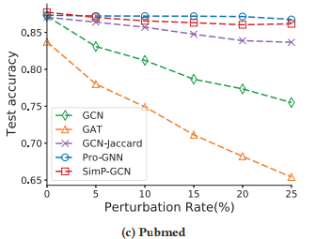
Experiments
As we can observe from the Figure, SimP-GCN consistently im-proves the performance of GCN under different perturbation rates of adversarial attack on all three datasets.Specifically, SimP-GCN improves GCN by a larger margin when the perturbation rate is higher. These observations suggest that by preserving node similarity, SimP-GCN can be robust to existing adversarial attacks.

Slide 18
Conclusion
We introduce a node similarity preserving graph convolutional neural network model, SimP-GCN, which effectively and adaptively balances the structure and feature information as well as captures pairwise node similarity via self-supervised learning. Extensive experiments demonstrate that SimP-GCN outperforms representative baselines on a wide range of real-world datasets.

Slide 19
Thank you！

